Slide 1
Endodontics
Lecture 3
Intracanal Instruments
By
Abdullah Mohammed Al Jawher
B.D.S. M.Sc. (conservative)

Slide 2
INSTRUMENT FABRICATION
Two techniques for manufacturing endodontic instruments have been developed:
Ground-Twisted:
Raw wire is ground into tapered geometric blanks; (square, triangular, and rhomboid). The blanks are then twisted counterclockwise to produce helical cutting edges.
Like in K-Files & Reamers.:
Machined:
This technique involves machining (grinding) the instrument directly on a lathe.
Like in Hedstrom file.

Slide 3
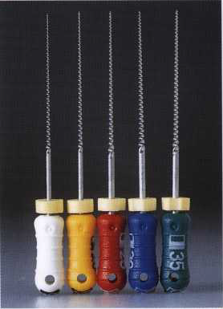
STANDARDIZATION:
Lengths
standard 25 mm; long 31 mm; and short 21 mm.
Special length 19 mm.
Sizing
numbers from 6 to 140 was based on the diameter of the instruments in hundredths of a millimeter at the beginning of the tip of the blades.

Slide 4
Classification of intracanal instruments
They are divided into six groups:
Group I: Manually-operated instruments, such as barbed broaches and K-type and H-­type instruments.
Group II: Low-speed instruments with a latch-type attachment. Typical instruments in this group are Gates-Glidden (GG) burs and Peeso reamers.
Group III: Engine-driven nickel-titanium rotary instruments.
Group IV: Engine-driven instruments that adapt themselves three-dimensionally to the shape of the root canal.
Group V: Engine-driven reciprocating instruments.
Group VI: Ultrasonic instruments.

Slide 5
Group I: Manually-operated instruments
Barbed Broaches
Barbed broaches are produced in a variety of sizes and color codes.
They were the earliest endodontic instruments used to extirpate the pulp.
A barbed broach does not cut or machine dentin; this instrument is mostly used to engage and remove soft tissue from the canal.

Slide 6
Files & Reamers:

Slide 8
Traditional instruments modifications
1- Nickel titanium file.
showed greater elastic flexibility and resistance to torsional fracture than stainless steel. This file has a non-cutting tip and it tends to maintain the curvature of the root canal.
2- Golden mediums
These instruments are a series of intermediate size instruments. They correspond in size to halfway between standard ISO sizes and correspond to 12,17,22,27,32 and 37 in number.
3- Canal Master U
This hand instrument is used to prepare the apical third of the canal. It has a non cutting pilot tip, 1 mm length cutting blade and a narrow parallel sided shaft. It is used to allow for better cutting with more space for debris accumulation and further removal. It reduces the possibility of ledge or transportation.

Slide 9
Group II: Low-Speed Rotary Instruments
Gates-Glidden drills

Slide 10
2. Peeso Drills

Slide 11
Group III: Rotary Instruments for Canal Preparation
Components of a file:
1- The taper.
The amount the file diameter increases each millimeter along its working surface from the tip toward the file handle.

Slide 12
2- The flute of the file.
It is the groove in the working surface used to collect soft tissue and dentin chips removed from the wall of the canal.

Slide 13
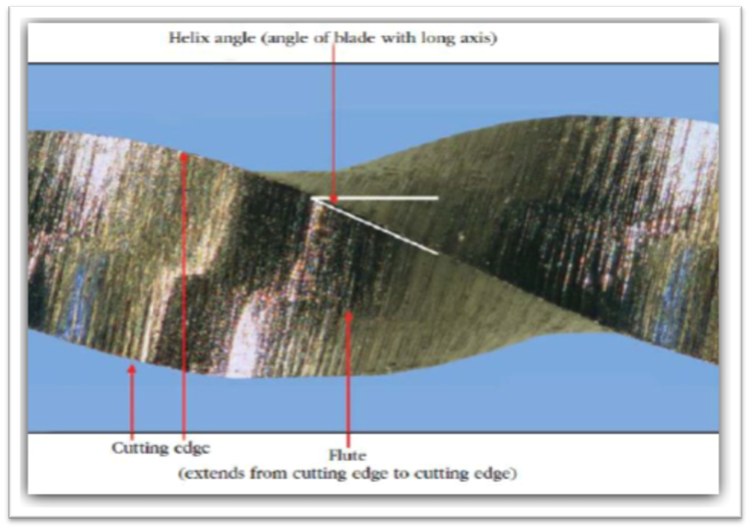
3- Helix angle.
It is the angle the cutting edge forms with the long axis of the file. It gathers debris collected in the flute from the canal.

Slide 14
4- Rake Angle
The rake angle can be seen as the angle between the leading edge of a cutting tool and a perpendicular to the surface being cut.

Slide 15
5- The pitch of the file.
is the distance between a point on the leading edge and the corresponding point on the adjacent leading edge.
The smaller the pitch or the shorter the distance between corresponding points, the more spirals the file has and the greater the helix angle.

Slide 16
Thank You

